Slide 1
Solving problems by searching
Searching for solutions
Chapter-3

Slide 2
Problem solving agents
Problem can be defined through five components:
  Initial state
  Actions available
  Transition model (What each action does)
  Goal test
  Path cost
Different search solutions can solve these problems.

Slide 3
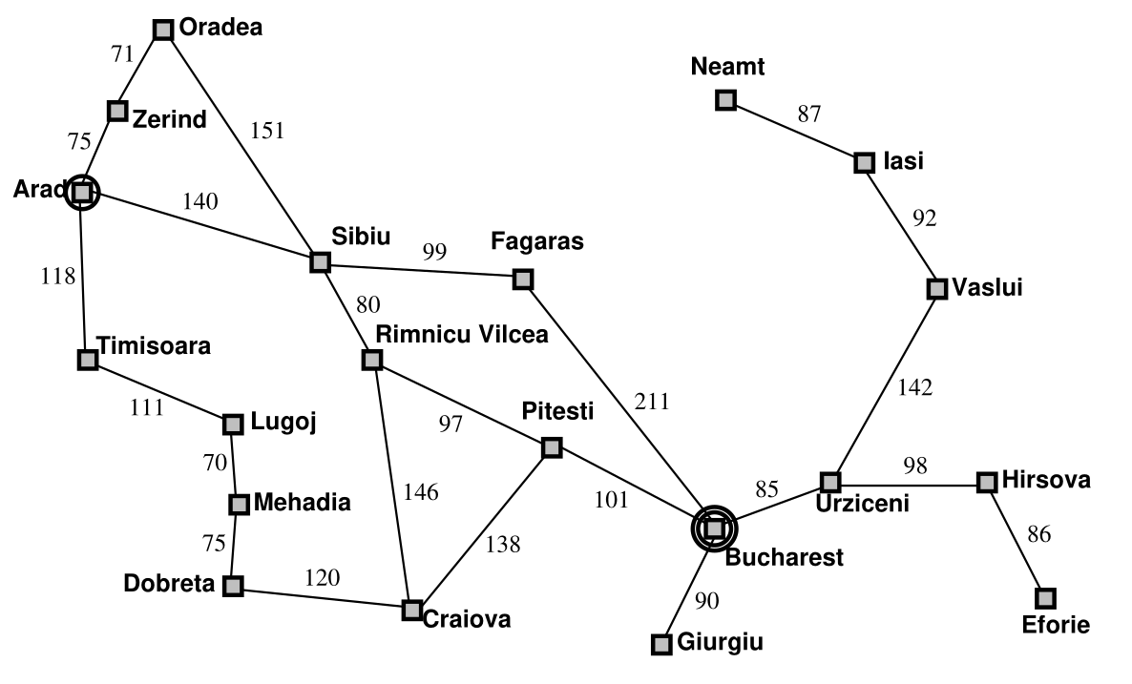
Problem solving agents – Example Romania

Slide 4
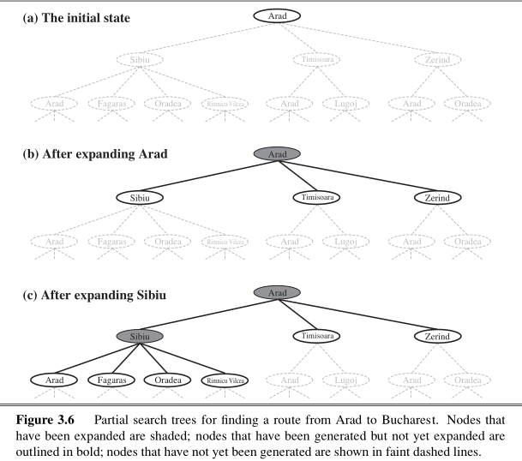
Searching for solutions

Slide 5
Searching for solutions
Take a search tree
  Start at the initial state of the search tree
  Expand the states i.e. generate a new set of states
  Expand till we find a solution, or there are no states to expand
  Avoid loopy paths i.e. don’t visit the nodes that are already visited.
  Sometimes explored set is also maintained which remembers each expanded state.

Slide 6
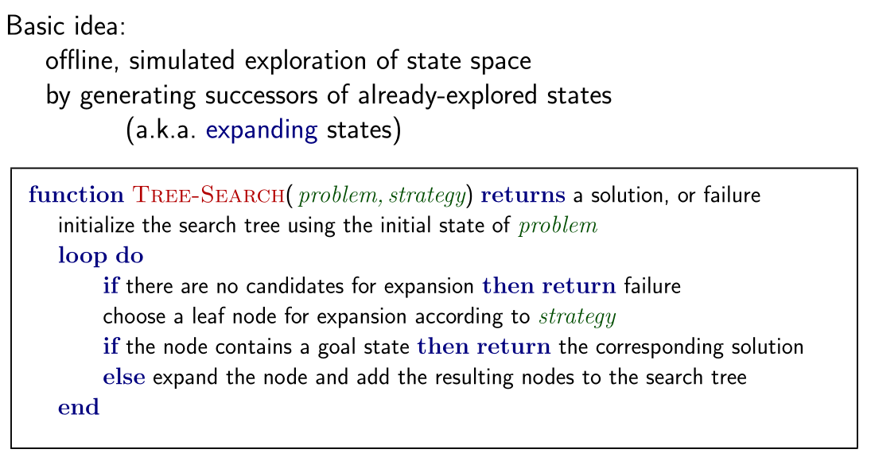
Searching for solutions

Slide 7
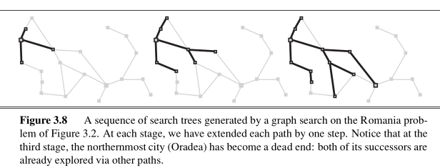
Searching for solutions

Slide 8
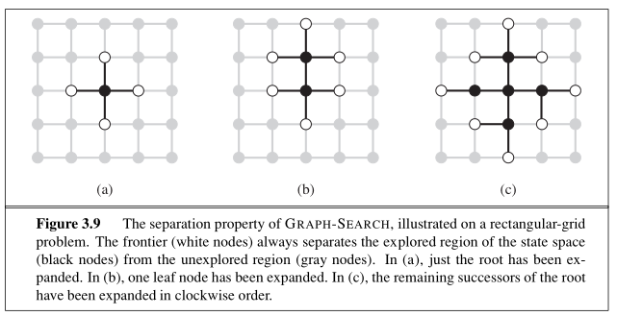
Searching for solutions

Slide 9
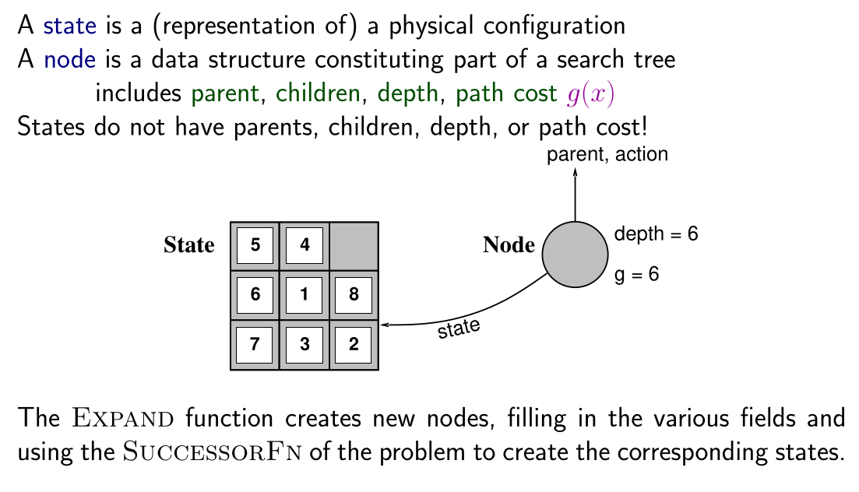
Searching for solutions – states vs nodes

Slide 10
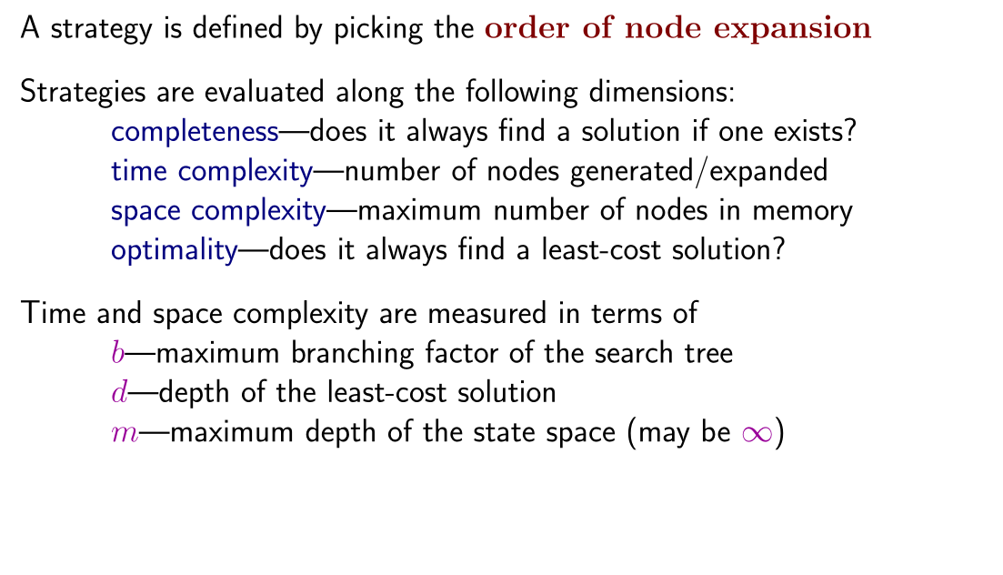
Searching for solutions – states vs nodes

Slide 11
Uninformed search strategies
Uninformed strategies use only the information available in the problem definition
  Breadth-first search
  Uniform-cost search
  Depth-first search
  Depth-limited search
  Iterative deepening search

